Slide 1
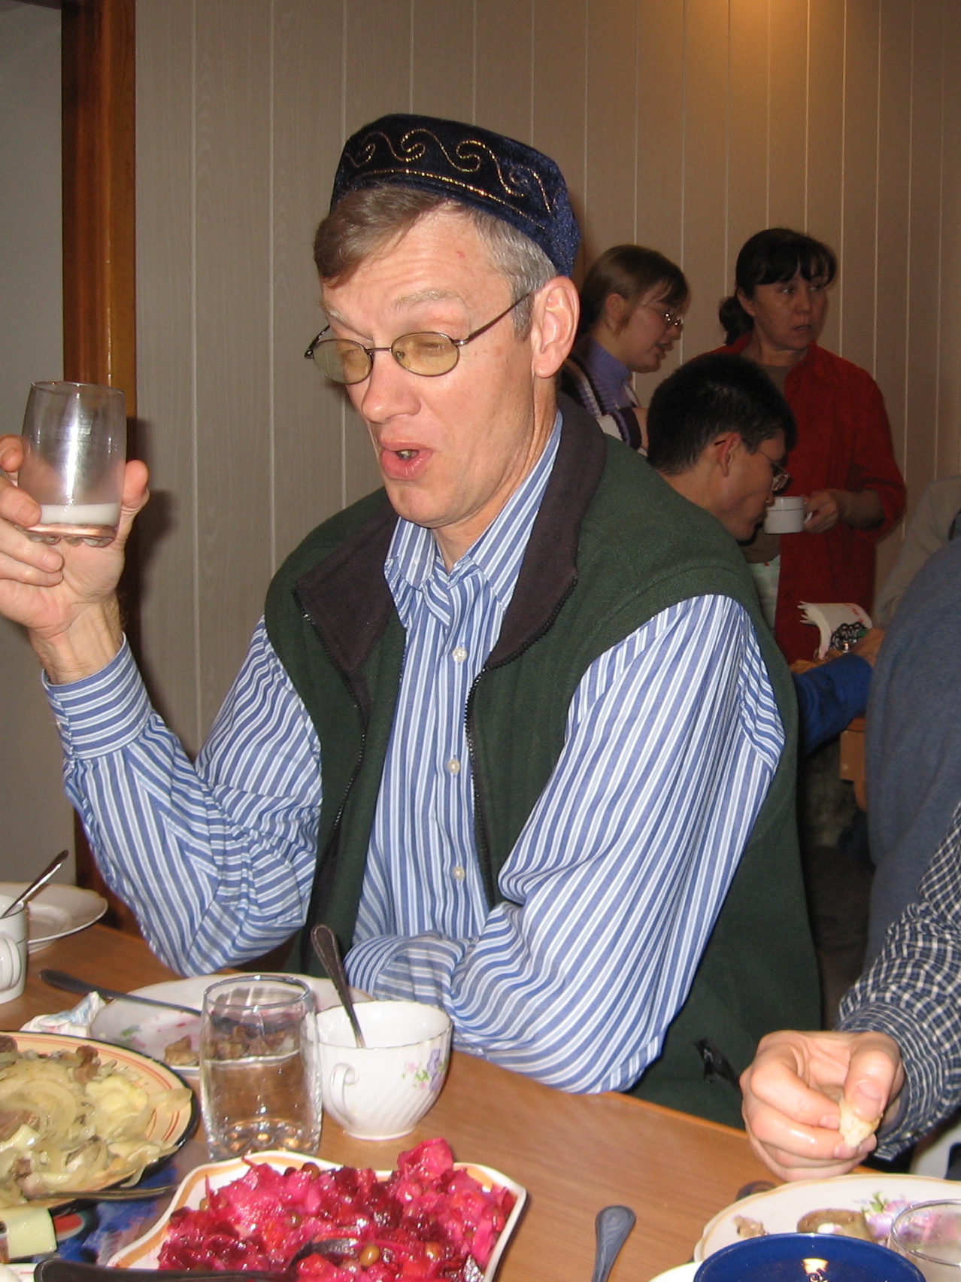
Navigating the nuances of money & missions
CRAIG PARRO

Slide 2


What ”success” looks like today
By God’s grace we will learn…
When good intentions are not good enough
When funding is appropriate…or not
Principles to guide our funding decisions

Slide 3
What scriptures should shape our thinking?
As for the rich in this present age, charge them not to be haughty, nor to set their hopes on the uncertainty of riches, but on God, who richly provides us with everything to enjoy. They are to do good, to be rich in good works, to be generous and ready to share, thus storing up treasure for themselves as a good foundation for the future, so that they may take hold of that which is truly life.
--1 Timothy 6: 17-19

Slide 4
Good intentions are not good enough
What are some ways that our funding can be harmful?
If it divides the Church and/or undermines her leaders
If it leads to fraud or misuse of funds
If it creates unhealthy dependencies
Notes:
$ can give power to the wrong person. EG Kialo: “Don’t take sides or play favorites. Think twice…how will your help affect the group?” Will it disrupt the group? Kailo: “Don’t take sides or play favorities. Think twice…how will your help affect the group.” Who are the recognized leaders? What is their leadership map?
$ can create jealousy, greed. EG: Anton in PNG. Plastic bags/2nd hand suitcase.
Will it undermine their leaders? EG. Car given to a PNG denominational leader. Bicycles given to elders in Zaire. Created confusion and suspicion. “Where did this money come from? Who are you beholdened to? Western puppet?” Hidden income and expenses.
Divide the church, undermine the church leaders, or elevate those who are not leaders.

Slide 5
Questions to ask ourselves
How might this funding cause harm?
Will it deflate their sense of agency?
Will it inflate our sense of agency?
$$$ too often leads to broken relationships

Slide 6
Questions to ask ourselves
Do we have a true partnership and genuine alignment?
Why are they saying ”yes?”
Who is setting the agenda?
Is money the most important resource?
Have we moved beyond a transactional relationship to a trusted friendship?

Slide 7
Questions to ask ourselves
Will this funding help build both their capacity and their sustainability?
What will the ministry look like after I’m gone?
Do they own it?
Am I willing to give up control?
>>>Focus on people & process, not programs & products

Slide 8
What ”success” looks like today
By God’s grace we will learn…
When good intentions are not good enough
When funding is appropriate, or not
Principles to guide our giving
>>>What are your take-aways?

Slide 9
Resources
Webinar: Navigating Cross-cultural Training Pitfalls www.craigparro.org
Books:
When Helping Hurts, Corbett & Fikkert
When Charity Destroys Dignity: Overcoming Unhealthy Dependency in the Christian Movement, Glenn Schwartz
Cross-Cultural Partnerships: Navigating the Complexities of Money and Mission, Mary Lederleitner

Slide 10


