Slide 1


Slide 2

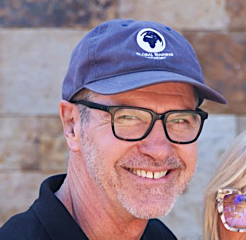
LEARNING TO ASK POWERFUL QUESTIONS
ELEVATE WEBINARS
With Phil Graf

Slide 3

Unscripted discussions with those pursuing a multiplication strategy January 20 with Linus Morris
TRAIN-THE-TRAINERS (T3) ZOOM CAFÉ

Slide 4
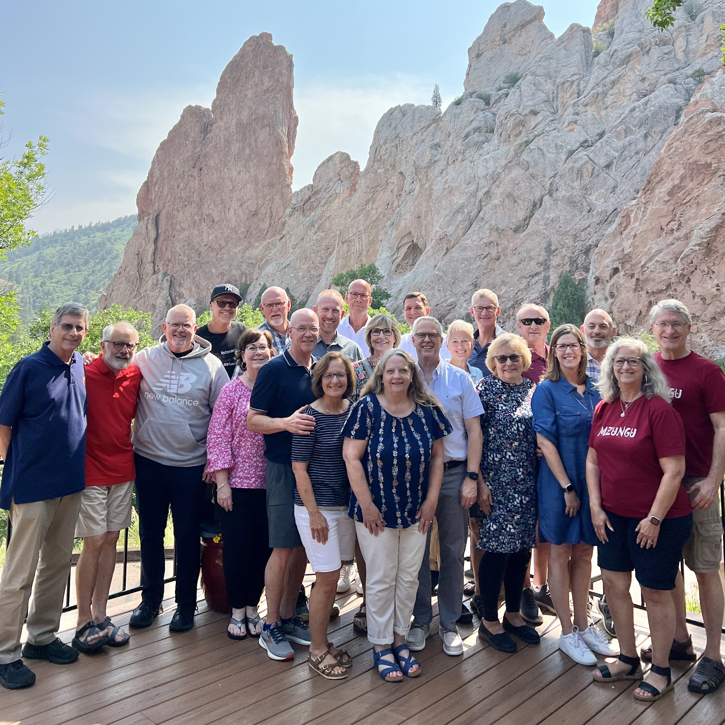
A transformational journey through Genesis Flagstaff, az July 21-24, 2026
IN-PERSON WORKSHOPS

Slide 5
LEARNING TO ASK POWERFUL QUESTIONS
ELEVATE WEBINARS
With Phil Graf
Repeated on January 8, 2026

Slide 6
What Success looks like today
Gain a deeper appreciation for asking powerful questions
Learn what makes for a powerful question
ID ways to use more powerful questions in your own teaching/training

Slide 7
What makes for a powerful question?
Thought-provoking… generates curiosity
Stimulates reflective conversation
Surfaces underlying assumptions
Evokes more questions
Generates energy & forward movement
Lingers with participants… touches a chord
Discerns where learners are at

Slide 8
Ways to Ask better awareness questions
1.Good, better, better still
2. Open, not closed
3. Non-judgmental
4. Neutral, not negative

Slide 9
Practice scenarios
1. You’ve lost the class. They’re no longer tracking with you. Lots of blank stares. You’re not sure where, when or how you lost them? What powerful questions might you ask to right the ship?

Slide 10
Practice scenarios
2. You’ve bumped into a cultural norm that seems to be at odds with the Scriptures. Perhaps it has to do with issues of integrity, morality, marriage, or leadership. What powerful questions might you ask to help the learners confront their cultural norm through the lens of Scripture?

Slide 11
Practice scenarios
3. You’re facing serious theological error. Perhaps some are advocating for a Prosperity gospel. What powerful questions might you ask to help the learners grasp the gospel more truly & more fully?

Slide 12
Practice scenarios
4. A Muslim friend is convinced that Christians worship multiple gods. What powerful questions might you ask to help him better see the beauty and glory of the Trinity, as well as the divinity of Christ?

Slide 13
questions to keep asking yourself
How can I make this course/lesson more about them and less about me?
Are they tracking with me? Where are they stuck…confused…unengaged?
Are they being transformed? How do I know?
Am I asking or telling? Why is asking better?

Slide 14
What Success looks like today
Gain a deeper appreciation for asking powerful questions
Learn what makes for a powerful question
ID ways to use more powerful questions in your own teaching/training

Slide 15
Thinking about your transformation…
What has been most helpful to you in this webinar?
What changes might you begin to make in your teaching/training?

Slide 16
Evaluating ourselves using a win process
1.What went Well?
2. What could be Improved?
3. What should we do Next?

Slide 17
Other Resources
Check out other resources for trainers of pastors @ craigparro.org
A helpful article: The Art of Powerful Questions: Catalyzing Insight, Innovation, and Action, by Vogt, Brown & Isaacs

