Slide 1
Bridging the Gap: Ways to Teach Those with Reading/Literacy Challenges
ELEVATE WEBINARS
With Craig Weaver

Slide 2
What Success looks like today
Identify key differences between Oral and Literate Preference Learners
Identify initial steps to adapt your teaching materials/approach to address Oral learning distinctives

Slide 3
Literate Preference Learners
Written
Digital
Individual
Abstract
Outlines
Structured
Lists
Logical
Analytical
Solitude
Essay
Library

Slide 6
Oral Preference Learners
Spoken Word
Storying
Groups
Campfire
Formulas
Communal
patterns
Re pe ti tion
Participatory
Song - Singing
Flexible
Characters
Concrete
Relational

Slide 11
Always seem to start with a formal setting sitting in rows

Slide 12
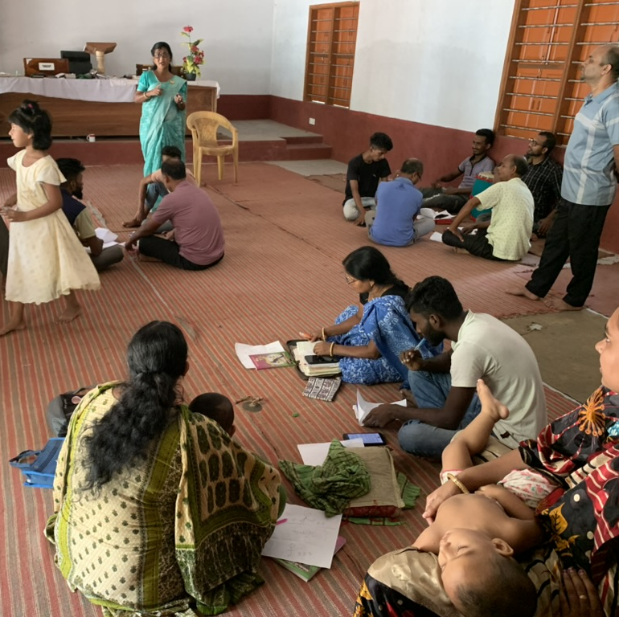
But we remain flexible and get into small groups for practice & discussion

Slide 13
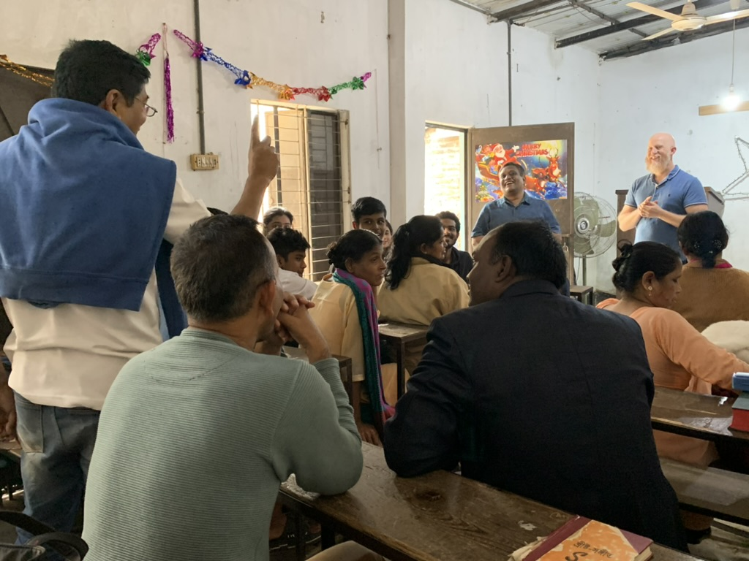
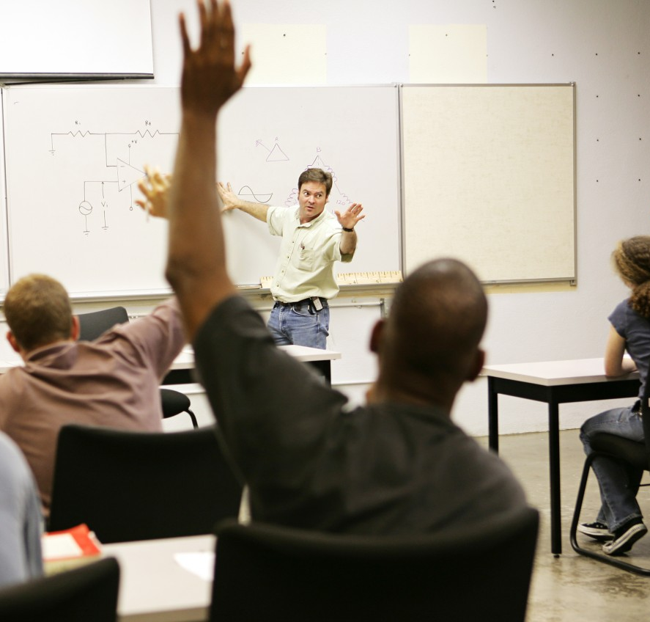
What do you see as examples of a Literate Learner?
What do you see as examples of an Oral Learner?

Slide 14
Contrasting Oral and Literate
Focus on Present
Community Based
Immediate Context
Alive & Active
Time is Cyclical
Continuity of Present
1. Detached
2. Individualistic
3. Long-term
4. Stored in Books
5. Linear & Historical
6. Past Present Future

Slide 15
Contrasting Oral and Literate
Spoken Word
Face to Face
Immediate
Repetition
Formulas
Redundant
Cultural Tradition
7. Written Word
8. Head in a Book
9. Stored on Shelf
10.Hard Drive
11.Foot Notes
12. Precise & Concise
13. Intellectual Property

Slide 16
Contrasting Oral and Literate
Oral Delivery
Discussion
Role Play-Story
Oral Test
Dialogue Circles
Visual-Audio Media
14. Written Textbook
15. Written Assignment
16.Lecture
17. Written Test
18.Independent Study
19.E-Book & PowerPoint

Slide 17
What Success looks like today
Identify key differences between Oral and Literate Preference Learners
Identify initial steps to adapt your teaching materials/approach to address Oral learning distinctives

Slide 18
What are your take-aways?
What changes might you begin to make in your teaching/training?
What questions might you ask your global partners to better navigate orality challenges in their context?

