Slide 2
Training Trainers: Making 2 Timothy 2:2 a reality
CRAIG PARRO
773.837.5539

Slide 3
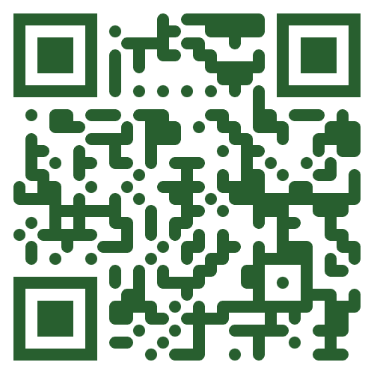
Elevate: 2024 opportunities to sharpen your skills as a gtn trainer
EVALUATING THE IMPACT OF YOUR TRAINING
(2-part Webinar)
June 6th and June 13th
Scan to register
www.gtn.org/elevate-webinars

Slide 4
Elevate: 2024 opportunities to sharpen your skills as a gtn trainer
NAVIGATING CROSS-CULTURAL TRAINING PITFALLS
(Webinar)
August 29th or November 21st
www.gtn.org/elevate-webinars

Slide 5
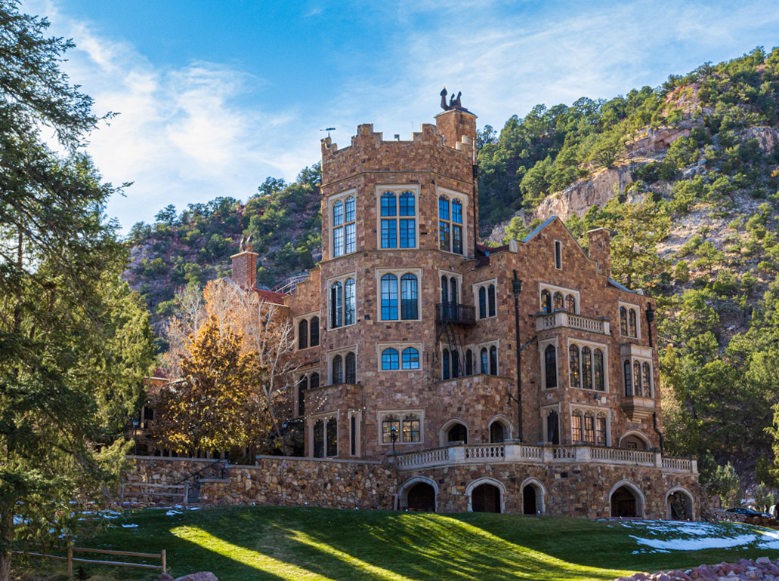
Elevate: 2024 opportunities to sharpen your skills as a gtn trainer
EQUIPPING YOU… TO DEVELOP PASTORS INTO EXPOSITORS (In-Person Workshop)
July 24-26, 2024
Colorado Springs, Colorado
Glen Eyrie Convention Center
Scan to register
www.gtn.org/elevate

Slide 6
Elevate: 2024 opportunities to sharpen your skills as a gtn trainer
SE REGIONAL STAFF GATHERING
(In person)
Myrtle Beach, South Carolina
October 23-25, 2024
Email Doug Dorman to register:
dougdorman@gmail.com
www.gtn.org/elevate-webinars

Slide 7
Training Trainers: Making 2 Timothy 2:2 a reality
CRAIG PARRO
773.837.5539

Slide 8
>>>What “success” looks like today
By God’s grace, you will…
Better understand barriers to a Train-the-Trainers strategy
Evaluate your own Train-the-Trainers mindset
Identify next steps to develop/deepen a Train-the-Trainers approach in your context
Notes:
Start Recording
Huge, complex topic
A group effort…Thanks Carl Green, Jim Baugh, Larry Meeker, Paul Madson, Doug Vinez, Phil Graf, Linus

Slide 9
A framework for developing trainers
The Why
The Mindset
The Who
The How
The Results

Slide 10
The mindset
What keeps developing trainers from being our priority?
Are we willing & able to make the relational investment?
Are we pursuing a partnership of equals?

Slide 11
The WHO
Do we have the right partner?
Have we/they chosen the right participants?
Have we identified the few to focus on?

Slide 12
The how
Do we have a solid plan to develop trainers?
Is our curriculum and training process easily
transferable?
Is multiplication sustainable?
Are we casting a compelling vision and creating
clear expectations for multiplication?

Slide 13
The results
Do we have robust feedback loops to monitor
progress and identify problems?
Are participants being transformed?
Is their capacity and confidence to handle God’s Word growing?
How widely and effectively are they multiplying the training?

Slide 14
What “success” looks like today
By God’s grace, you will…
Better understand barriers to a Train-the-Trainers strategy
Evaluate your own Train-the-Trainers mindset
Identify next steps to develop/deepen a Train-the-Trainers approach in your context
Notes:
Start Recording
Huge, complex topic
A group effort…Thanks Carl Green, Jim Baugh, Larry Meeker, Paul Madson, Doug Vinez, Phil Graf, Linus

Slide 15
FEEDBACK FOR TODAY
What are 1-2 take-aways for you?
Which questions would you like to explore more fully?
What could have been more helpful or improved?

Slide 16
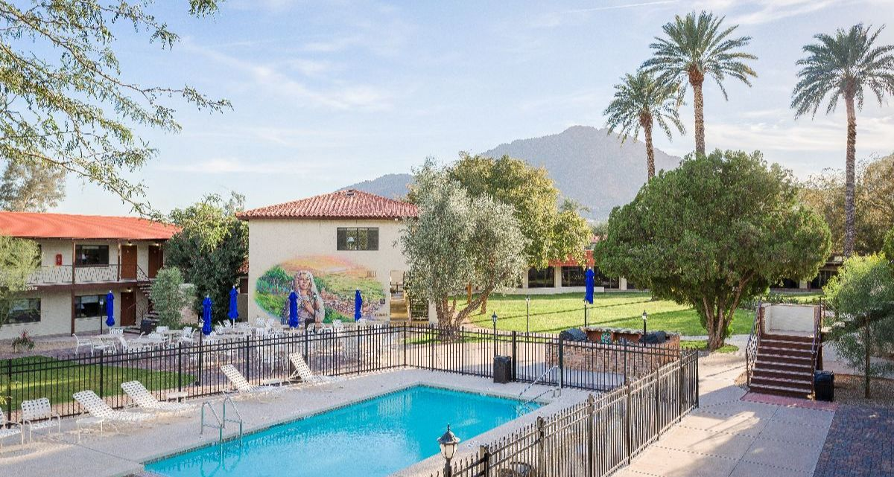
Elevate: a 2025 opportunity to sharpen your skills as a gtn trainer
HELPING YOU DEVELOP & REFINE
A TRAIN THE TRAINERS MODEL
A Two-day, In-Person Workshop
(immediately after the 2025 LG)
MARCH 2-3, 2025
Franciscan Retreat Center
Scottsdale, AZ
www.gtn.org/elevate

Slide 18
COUNTERINTUITIVE LESSONS LEARNED
LESS IS MORE
(BIGGER ISN’T BETTER)
SIMPLE CAN BE PROFOUND
(AND MORE TRANSFERABLE)
What is learned is more important than what is taught
Go slower to go farther
(time is our friend)
Focus on a few to get to the many
(go deeper to go wider)

Slide 19
COUNTERINTUITIVE LESSONS LEARNED
THEY MUST INCREASE (WE MUST DECREASE)
National teams bring exponential growth

